Slide 1

Azure
Landing Zone
Accelerators

Slide 2
Accelerator Components
Phases
Docs and Bootstrap
1 Pre-requisites
Documentation
Phase-by-phase and Step-by-step instructions
Create the pre-requisites
Elevated Account
SP or user account with management group and subscription owner permissions
Subscriptions
Identity, Management and Connectivity
PowerShell Module
(Deploy-Accelerator)
2 Bootstrap
Bootstrap Modules
Automated Bootstrap
GitHub or Azure DevOps
Repos, CI / CD, Environments, Approvals, Variables, Agents etc…
Azure
IAM, State Management, Agent Compute, etc…
GitHub
Azure DevOps
Local File System
3 Run
Starter Modules
Deploy
Run the Pipeline / Action to deploy the landing zone
Iterate
Update your module for specific needs / updates and re-run the pipeline
Bicep
Terraform

Slide 3










Microsoft Azure
Version Control System
Identity
Repository
Service Connections
Branch policy
Plan
Apply
Permissions applied for ALZ module
Starter module files and variables
Plan
User Assigned Managed Identities for Plan and Apply with Federated Credentials
Environments
Apply
State
Plan
Apply
Approvals
Approvals
Concurrency control
Concurrency control
Group / Team
Agent Pool / Runner Group
Storage Account and Container
Approvers
Agent 1
Agents / Runners
Pipelines / Actions
Private Networking
Agent 2
CI
CD
- apply
- destroy
Container Registry
Variable Set / Repository Variables
Container Instances Running Agents

Slide 4
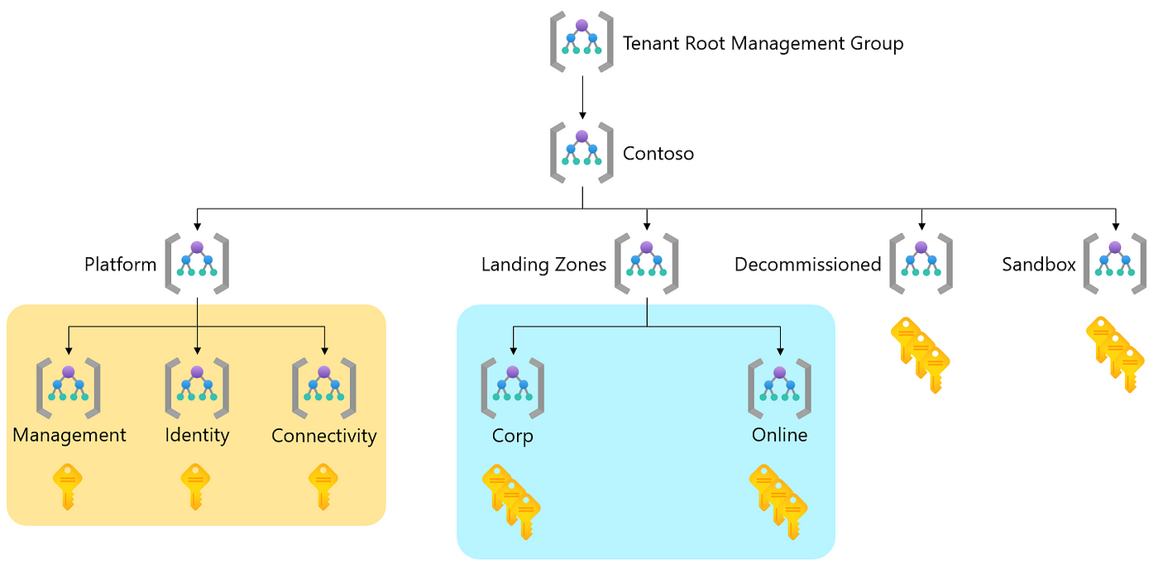
Sample – Azure Landing Zone

Slide 5
Bootstrap your environment
Deploy Azure platform landing zone components
Subscription (LV Vending process)
Deploy workload landing zone components
Whether you’re a Brownfield or Greenfield customer, if you’re looking to implement a new ALZ environment based on best practices you’ll require multiple subscriptions.
Accelerate the deployment of platform resources based upon ALZ conceptional architecture. Deployment options are available via Azure Portal, Terraform and Bicep. They assist with the deployment of management group hierarchy, governance baseline, connectivity management and security components.
To accelerate the deployment of individual landing zones within an Azure tenant, a subscription vending solution is recommended. Vending helps deploy a subscription and the core resources (ie networking. Subscription vending is also available using both Terraform and Bicep.
There are multiple Landing Zone accelerators that provide a specific architectural approach and reference implementation, for workload scenarios. These accelerators prepare landing zone subscriptions for enterprise deployments like Azure Virtual Desktop, SAP, AKS etc. These accelerators are available in a wide range of deployment options.
Create Platform subs
Create Platform
LZ Vending
Deploy workload
Create subscriptions
ALZ Accelerator (Azure Portal)
LZ Vending module (Terraform)
AKS Accelerator
Others…
ALZ subscription vending modules
ALZ Bicep modules
ALZ Terraform modules
LZ Vending module (Bicep)
APIM Accelerator

Slide 6
Bootstrap your environment
Deploy Azure platform landing zone components
Subscription (LV Vending process)
Deploy workload landing zone components
Whether you’re a Brownfield or Greenfield customer, if you’re looking to implement a new ALZ environment based on best practices you’ll require multiple subscriptions.
Accelerate the deployment of platform resources based upon ALZ conceptional architecture. Deployment options are available via Azure Portal, Terraform and Bicep. They assist with the deployment of management group hierarchy, governance baseline, connectivity management and security components.
To accelerate the deployment of individual landing zones within an Azure tenant, a subscription vending solution is recommended. Vending helps deploy a subscription and the core resources (ie networking. Subscription vending is also available using both Terraform and Bicep.
There are multiple Landing Zone accelerators that provide a specific architectural approach and reference implementation, for workload scenarios. These accelerators prepare landing zone subscriptions for enterprise deployments like Azure Virtual Desktop, SAP, AKS etc. These accelerators are available in a wide range of deployment options.
Create Platform subs
Create Platform
LZ Vending
Deploy workload
Create subscriptions
ALZ Accelerator (Azure Portal)
LZ Vending module (Terraform)
AKS Accelerator
Others…

Slide 7
The time is now, go build!

